Slide 1
Data Exploration and Prediction of House Price
Part I Introduction Goal Predict the sale price of houses. Dataset Description In this dataset, there are 1460 observations with 79 explanatory variables describing (almost) every aspect of residential homes in Ames, Iowa. Among explanatory variables, there are 37 integer variables, such as Id, MSSubClass, LotFrontage, and 43 factor variables, such as MSZoning, Street, LotShape. Descriptive analysis and quantitative analysis will use subsets of it depending on models. First part of this report: Descriptive and Exploratory Analysis Second part of this report: Predictive Analysis.

Slide 2
Part II Data Assessment 2.1 Import Data
# list rows of data that have missing values missing_row <- train[!complete.cases(train),] head(missing_row)
train = read.csv("C:/Users/czone/Desktop/vikash ATI Class/house_prices/train.csv")
test = read.csv("C:/Users/czone/Desktop/vikash ATI Class/house_prices/test.csv")
View(train)
View(test)
library(ggplot2)
library(dplyr)
l
# list rows of data that have missing values
missing_row <- train[!complete.cases(train),]
head(missing_row)

Slide 3
# list rows of data that have missing values missing_row <- train[!complete.cases(train)] head(missing_row) nrow(missing_row)
2.3 Select Variables Step 1: select variables that may have greater impact on house price Step 2: build subset of train dataset for prediction.
## show all variable names
var_name <- names(train)
var_name

Slide 4
#Here, we select these important variables by creating a vector that contains variable names
select_var <- c('Id','MSZoning','Utilities', 'Neighborhood','BldgType','HouseStyle', 'OverallQual','OverallCond','YearBuilt', 'ExterQual','ExterCond', 'BsmtQual','BsmtCond','TotalBsmtSF','Heating','HeatingQC', 'CentralAir','Electrical','GrLivArea','BedroomAbvGr','KitchenAbvGr', 'KitchenQual','TotRmsAbvGrd','Functional','Fireplaces','FireplaceQu', 'GarageArea','GarageQual','GarageCond','OpenPorchSF','PoolArea', 'Fence','MoSold','YrSold','SaleType','SaleCondition','SalePrice')

Slide 5
# construct subset of train dataset that is used for prediction select_train <- train[,select_var]
head(select_train)
summary(select_train)
To get better understanding about this dataset, I summaried all importabt variables in terms of minimum, first quartile, median, mean, third quantile and maximum value.
2.4 Descriptive and exploratory analysis of SalePrice
SalePrice is our target variable and also the dependent variable for prediction. According to the assumptions of Linear Regression, data should be normally distributed. By checking the distribution of SalePrice, we can decide if we need non-linear transformation, like log term, to make better prediction.

Slide 6
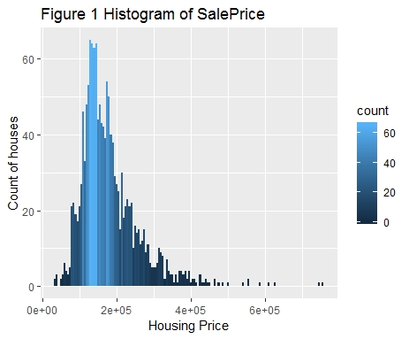
summary(select_train$SalePrice)
ggplot(select_train, aes(x = SalePrice, fill = ..count..)) +
geom_histogram(binwidth = 5000) +
ggtitle("Figure 1 Histogram of SalePrice") +
ylab("Count of houses") +
xlab("Housing Price")
From the histogram above, the distribution of our target variable-- SalePrice is skewed to right. Thus, a log term of SalePrice should be generated for linear regression. Here, we name it lSalePrice.

Slide 7
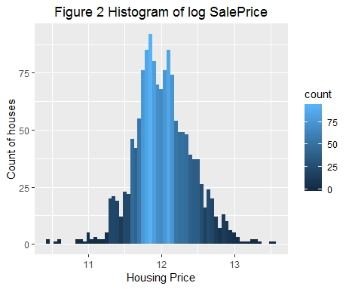
select_train$lSalePrice = log(select_train$SalePrice)
ggplot(select_train, aes(x = lSalePrice, fill = ..count..)) +
geom_histogram(binwidth = 0.05) +
ggtitle("Figure 2 Histogram of log SalePrice") +
ylab("Count of houses") +
xlab("Housing Price") +
theme(plot.title = element_text(hjust = 0.5))

Slide 8
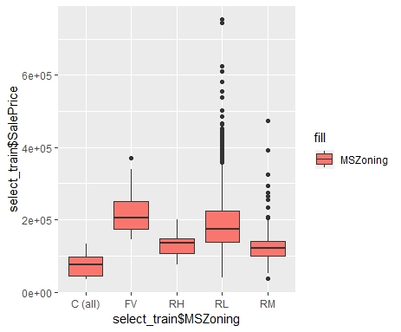
table(select_train$MSZoning)
ggplot(select_train , aes(x= select_train$MSZoning , y= select_train$SalePrice , fill = "MSZoning"))
+ geom_boxplot()
The graph above shows the distribution of SalePrice by MSZoning. The sales in "Floating Village Residential" area have the highest average sale price, and then followed by "Residential Low Density". While "Commercial" sales have the lowest average sale price. It is quite strange that commercial area has the lowest average Sale Price while village area has the highest.

Slide 9
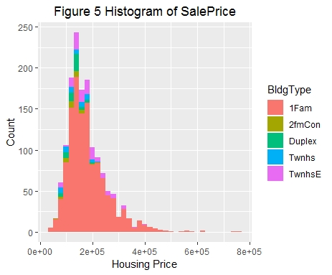
ggplot(select_train, aes(SalePrice)) +
geom_histogram(aes(fill = BldgType), position = position_stack(reverse = TRUE), binwidth = 20000) +
ggtitle("Figure 5 Histogram of SalePrice") + ylab("Count") +xlab("Housing Price") +
theme(plot.title = element_text(hjust = 0.5))
More thoughts about the graph above:
For houses with type of Single-family Detached, most of their prices are within the range from 50000 to 300000
For Two-family Conversion, Duplex, Townhouse End Unit and Townhouse Inside Unit, most of house prices are ranging from 75000 to 210000
The highest and lowest house price both come to Single-family Detached house type

Slide 10
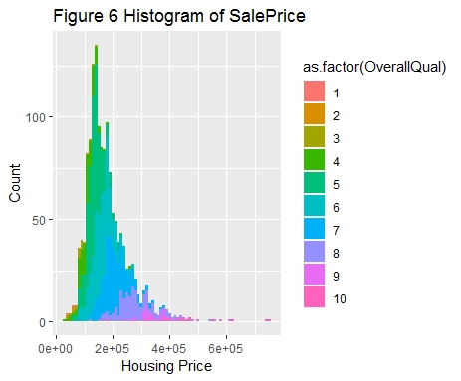
ggplot(select_train, aes(x = SalePrice,fill = as.factor(OverallQual))) +
geom_histogram(position = "stack", binwidth = 10000) +
ggtitle("Figure 6 Histogram of SalePrice") +
ylab("Count") +
xlab("Housing Price")
Most houese are with OverallQuall of 4,5,6 and 7, equivalent to "Below Average", "Average", "Above Average" and "Good"
The higher rate of overall quality, the higher house sale price

Slide 11
p1 <- ggplot(select_train, aes(x=GrLivArea, y=SalePrice)) +
geom_point(shape=1) +
geom_smooth(method=lm , color="red")
p2 <- ggplot(select_train, aes(x=TotalBsmtSF, y=SalePrice)) +
geom_point(shape=1) +
geom_smooth(method=lm , color="red")
p3 <- ggplot(select_train, aes(x=TotRmsAbvGrd, y=SalePrice)) +
geom_point(shape=1) +
geom_smooth(method=lm , color = "red")
p4 <- ggplot(select_train, aes(x=GarageArea, y=SalePrice)) +
geom_point(shape=1) +
geom_smooth(method=lm , color="red")
library(gridExtra)
grid.arrange(p1 ,p2 , p3 ,p4)

Slide 12
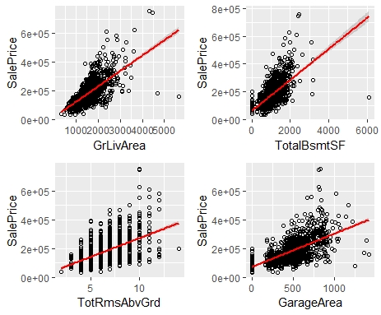

Slide 13
library(ggpubr)
ggscatter(select_train, x ="GarageArea", y= 'SalePrice' , add = "reg.line",color = "red" , conf.int = T , cor.method = "pearson")
nm_vr = select_if(select_train ,is.numeric)
names(nm_vr)
nrow(nm_vr)
ncol(nm_vr)
as.matrix(nm_vr)
dim(nm_vr)
u = cor(nm_vr)
corrplot(u , method = "color")

Slide 14
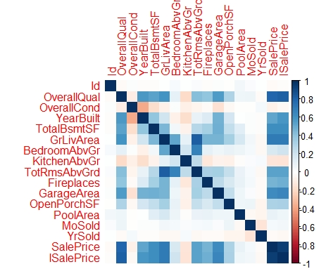

Slide 15
model_lm <- lm(log(SalePrice)~
OverallQual+OverallCond+YearBuilt+ExterCond+
TotalBsmtSF+HeatingQC+
CentralAir+GrLivArea+BedroomAbvGr+KitchenAbvGr+
TotRmsAbvGrd+Fireplaces+
GarageArea+OpenPorchSF+PoolArea+
YrSold , data = train)
summary(model_lm)
predict_price = predict(model_lm , test)
predict_price
Residual standard error: 0.1565 on 1437 degrees of freedom Multiple R-squared: 0.8489, Adjusted R-squared: 0.8465 F-statistic: 366.9 on 22 and 1437 DF, p-value: < 2.2e-16
>

